Slide 1
Deadlocks in Distributed Systems
Lecture-20

Slide 2
Introduction
There are two kinds of distributed deadlock:
Communication deadlock: It occurs, for example, when process A is trying to send a message to process B, which in turn is trying to send one to process C which is trying to send one to A.
There are various senarios in which this situation leads to deadlock, such as no buffer being available.
Resource deadlock: It occurs when processes are fighting over exclusive access to I/O devices, files, locks, or other resources.
Four Strategies used to handle Deadlock:
The Ostrich Algorithm (Ignore the Problem)
Deadlock Detection (let deadlock occur, detect them, and try to recover)
Prevention (Make deadlock structurally impossible)
Deadlock Avoidance (Avoid deadlock by allocating resource carefully)

Slide 3
Cont..
Deadlock avoidance is never used in distributed systems.
The problem is that the banker's algorithm and similar algorithms need to know (in advance) how much of each resource every process will eventually need. This information is rarely, If ever, available.
Centralized Deadlock Detection:
As a first attempt, we use a centralized deadlock detection algorithm and then try to imitate the non-distributed algorithm.
Each machine maintains the resource graph for its own processes and resources, and a central coordinator maintains the resource graph for the entire system (the union of all the resource graphs)
When the coordinator detects a cycle, it kills off one process to break the deadlock.

Slide 4
Cont..
Unlike the centralized system (single processor), in a distributing environment, all the information has to be sent to the right place explicitly.
Here, each machine maintains a graph for its own processes and resources.
Possible situations to get the informations to the right place:
Whenever, an arc is added or deleted from the resource graph, a message can be sent to the coordinator providing the update.
Periodically, every process can send a list of arcs added or deleted since the previous update. This method requires fewer messages than the first one.
The coordinator can ask for informations when it needs it.
Unfortunately, none of these methods work well. Why ?

Slide 5
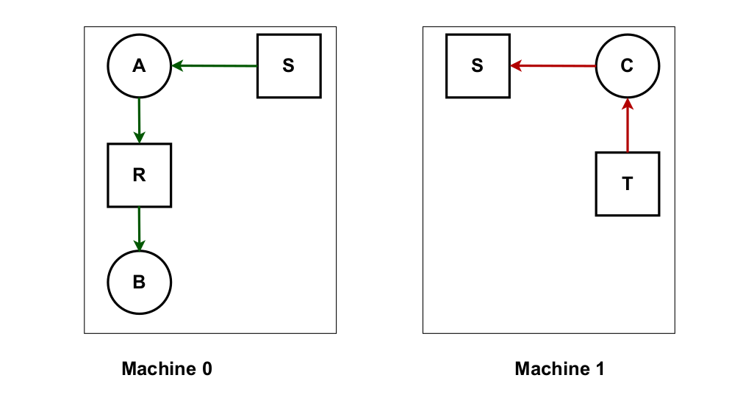
Cont..
Centralized Deadlock Detection Explanation:
Process A and Process B are running in Machine 0, and Process C is running in Machine 1.
Three resources exist: R, S, and T.
A holds S but wants R, which it cannot have because B is using it; C has T wants S.

Slide 6
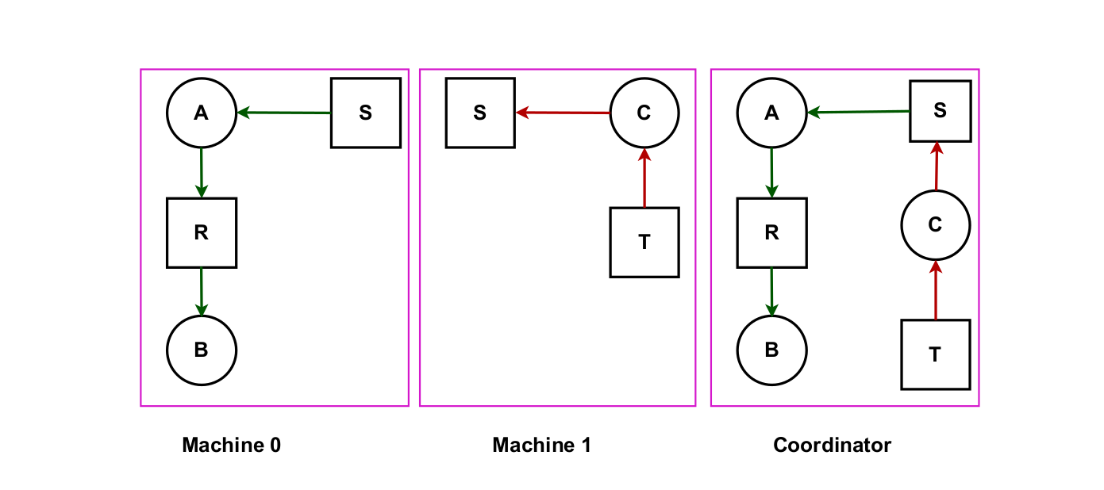
Cont..
We can see the coordinator view of Machine 0 and Machine 1.

Slide 7
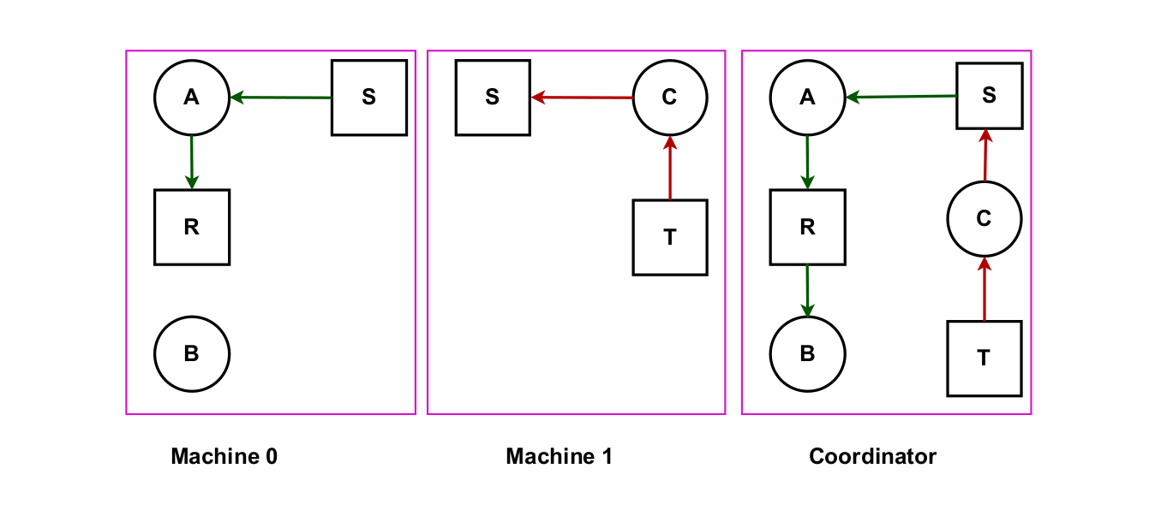
Cont..
As soon as B finishes, It releases R:

Slide 8
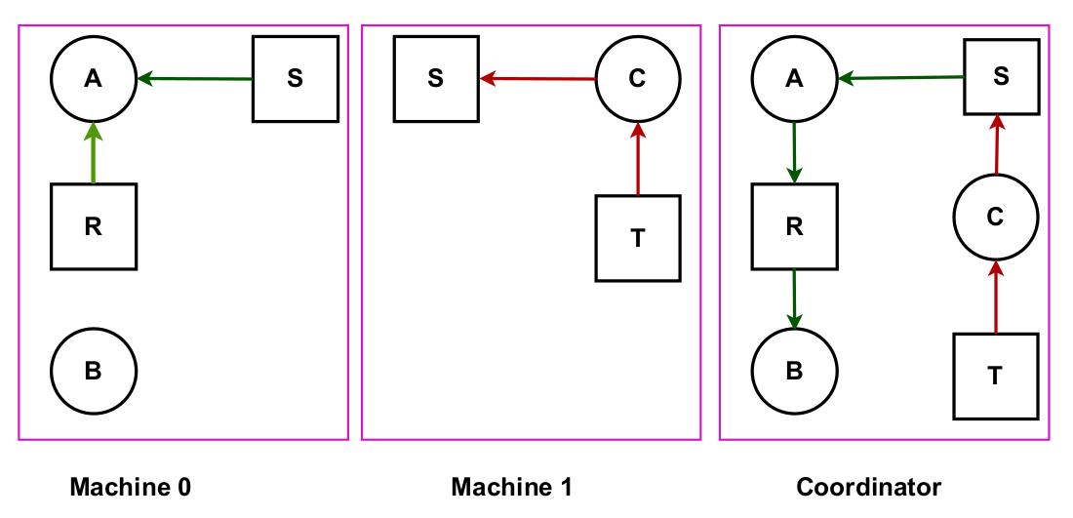
Cont..
A gets R and finishes its task, releasing S for C:

Slide 9
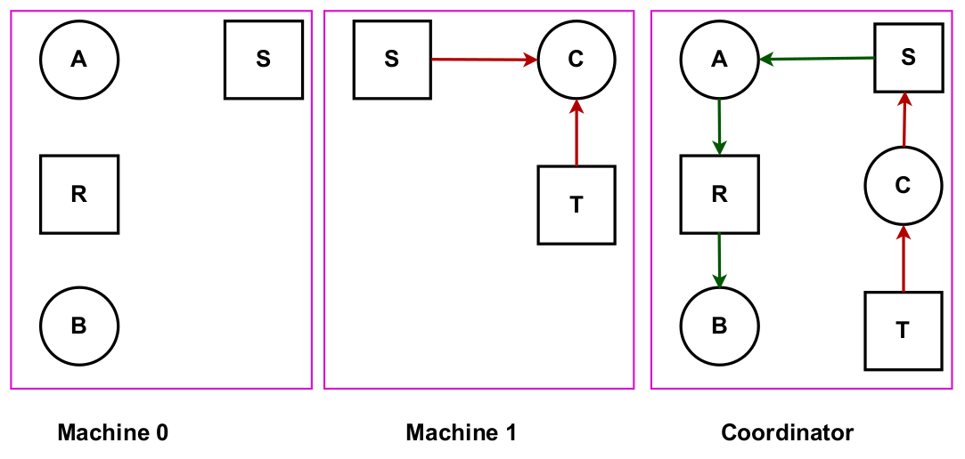
Cont..
Now C has both S & T, now C can execute its task:

Slide 10
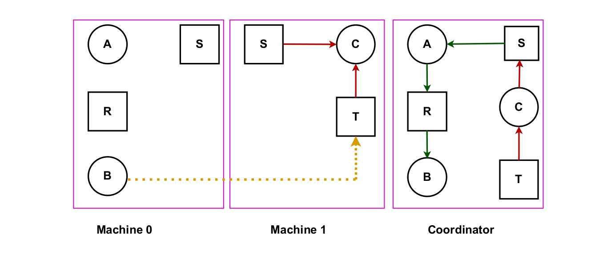
Cont..
Meanwhile, B is requesting for T:

Slide 11
Cont..
Machine 0 sends a message to the coordinator announcing the release of R.
Machine 1 sends a message to the coordinator announcing the fact that B is requesting the resource, T.
Unfortunately, the message from Machine 1 arrives first, leading the coordinator to construct the graph as shown above.
Coordinator incorrectly concludes that a deadlock exists and kills some process.
Such a situation is called False deadlock.

Slide 12
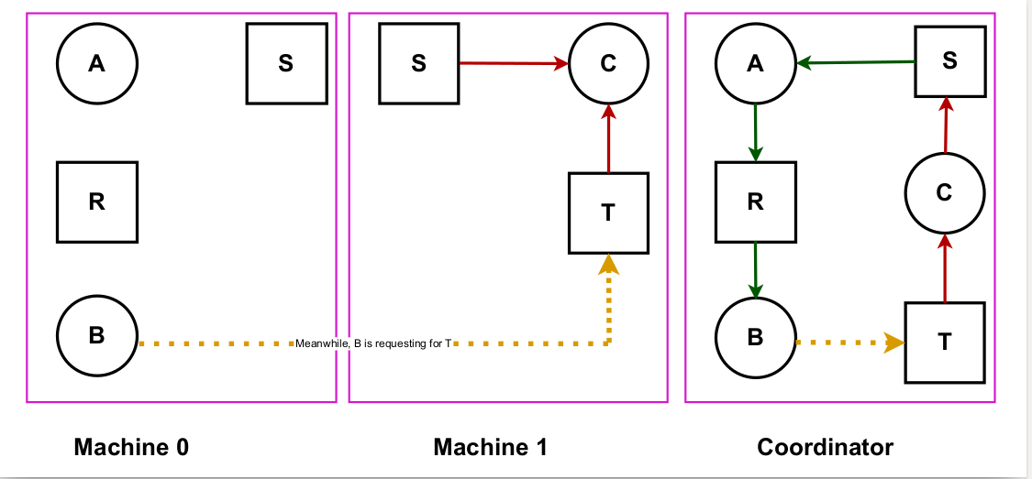
Cont..
False deadlock situation:

Slide 13
Cont..
Many deadlock algorithms in distributed systems produce False deadlocks like this due to incomplete or delayed information.
One possible way out might be to use Lamport’s algorithm to provide global time.
i) Message from machine 1 to the coordinator is triggered by the request from machine 0, so the message from machine 1 will have later timestamp than the message from machine 0 to the coordinator.
ii) When the coordinator gets a message from machine 1 that leads it to suspect deadlock, it could send a message to every machine to the system saying that: “ I just received a message with timestamp T that leads to deadlock. If anyone has a message for me with earlier timestamp, send me immediately.”
iii) When every message will send positively or negatively, the coordinator will see that arc from R to B is vanished. Hence, the system is still safe.

Slide 14
Cont..
Distributed Deadlock Detection:
When a deadlock is detected in a system based on atomic transactions, it is resolved by aborting one or more transactions.
When a transaction is aborted because it contributes to a deadlock, the system is first restored to the state it had before the transaction began, at which point the transaction can start again.
Chandy-Misra-Haas Algorithm for distributed deadlock detection:
Idea of the algorithm:
Processes are allowed to request multiple resources at once, instead of one at a time. (See the figure in the next slide, where Process 3 at Machine 1 is waiting for two resources, one held by Process 4 and one held by Process 5)
It implies, the growing phase of a transaction speeds up considerably.
Consequently, a process may now wait on two or more resources simultaneously.

Slide 15
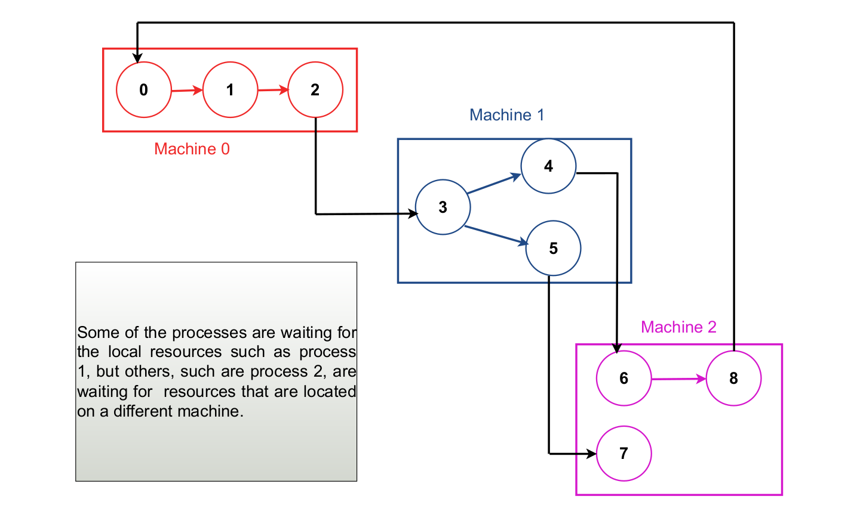
Cont..
Chandy-Misra-Haas Algorithm:

Slide 16
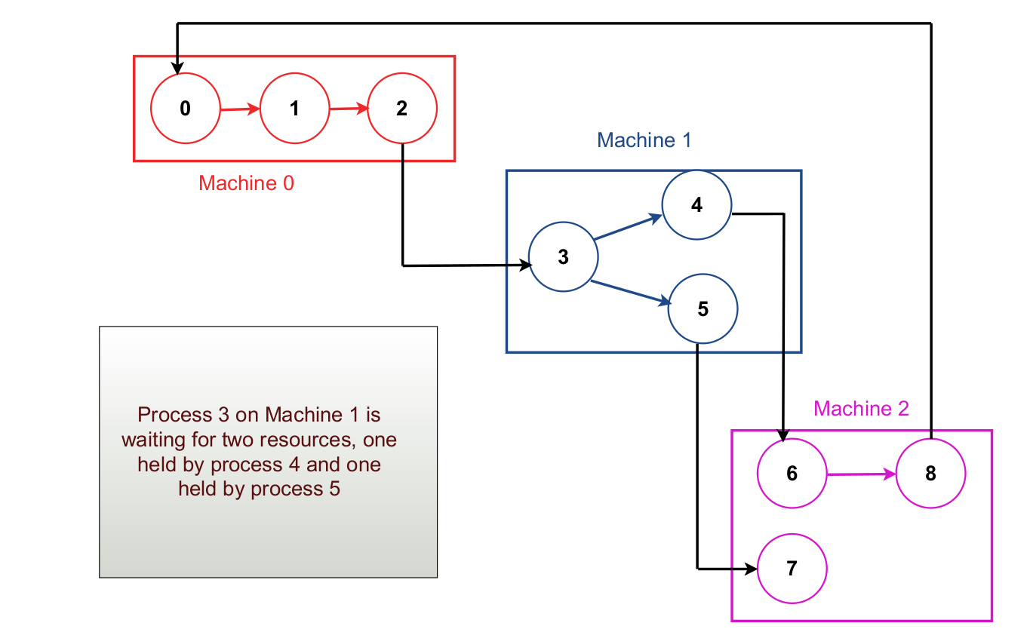
Cont..

Slide 17
Cont..
The Chandy-Misra-Haas Algorithm is invoked when a process has to wait for some resources, process 0 blocking on process 1.
At that point, a special probe message is generated and sent to the process(es) holding the needed resources.
The probe message consists of three numbers:
The Process that just blocked
The process sending the message
The Process to whom it is being sent.
The initial message from 0 to 1 contains the triple (0,0,1)
4. When the message arrives, the recipient checks to see if it itself is waiting for any processes.
5. If so, the message is updated:
i) Keeping the first field the same but
ii) replacing the second field by its own process number and
iii) The Third one by the number of process it is waiting for.

Slide 18
Cont..
6. The message is sent to the process on which it is blocked. If it is blocked on multiple processes, all of them are sent (different) messages.
7. If the message goes all the way around and comes back to the original sender, that is, the process listed in the first field, a cycle exists and system is deadlocked.

Slide 19
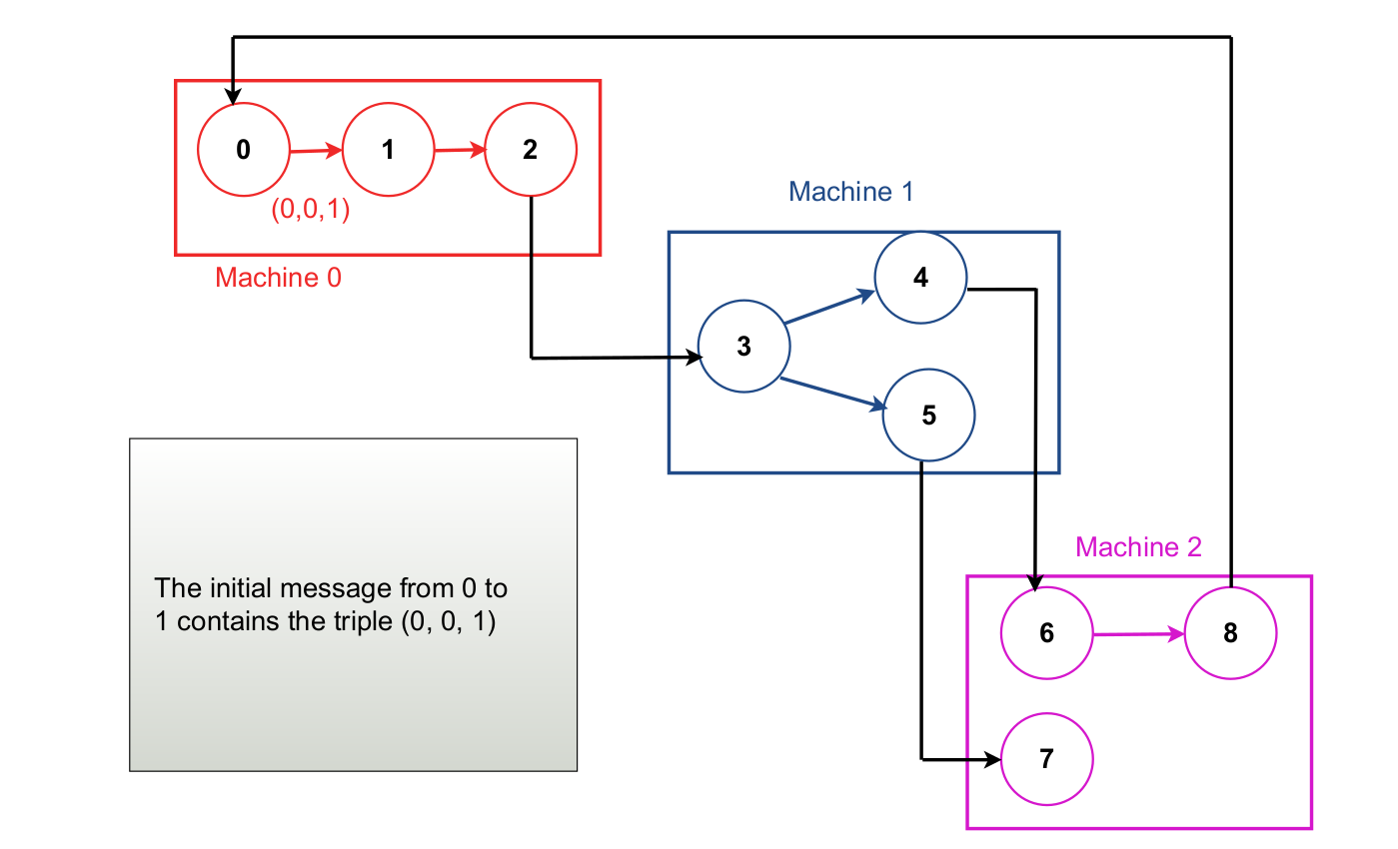
Cont..

Slide 20
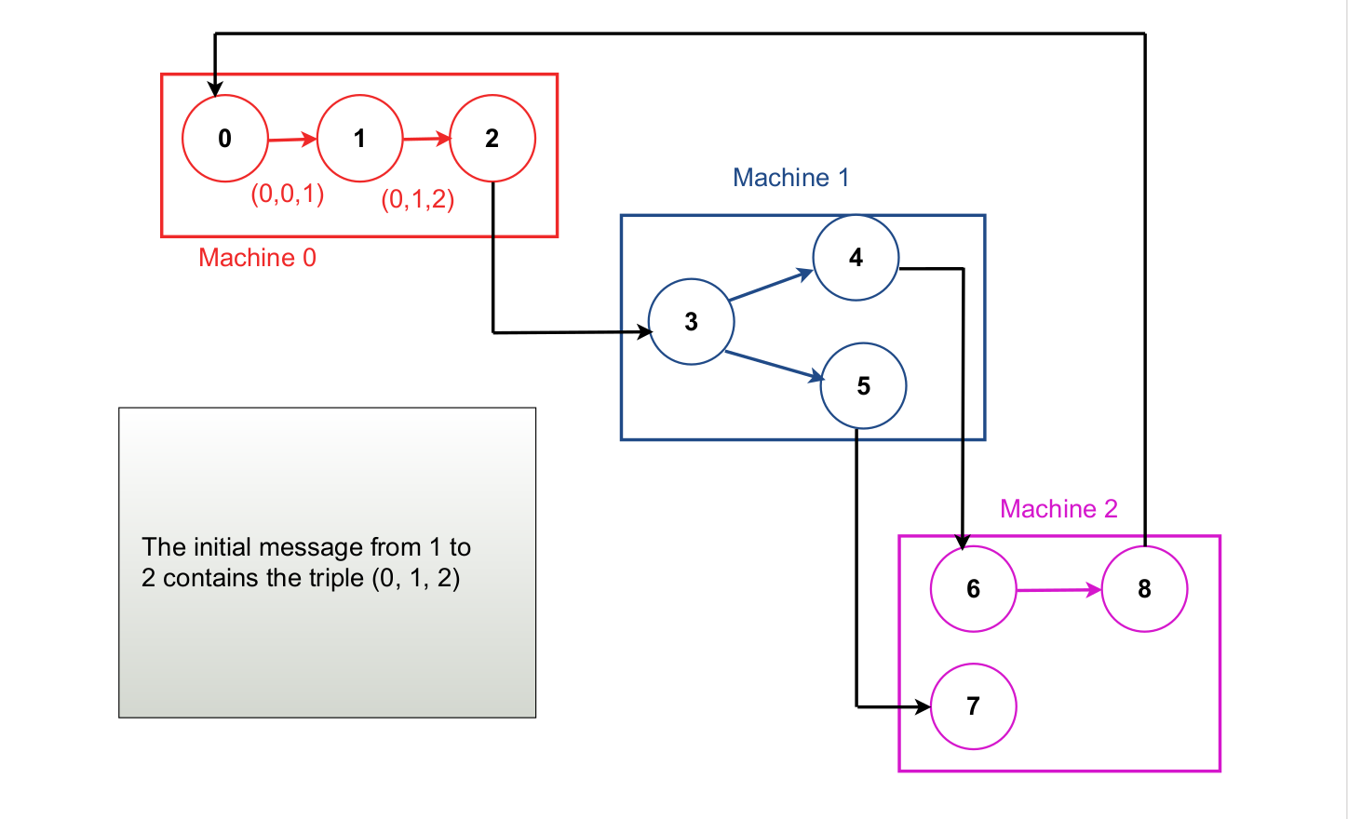
Cont..

Slide 21
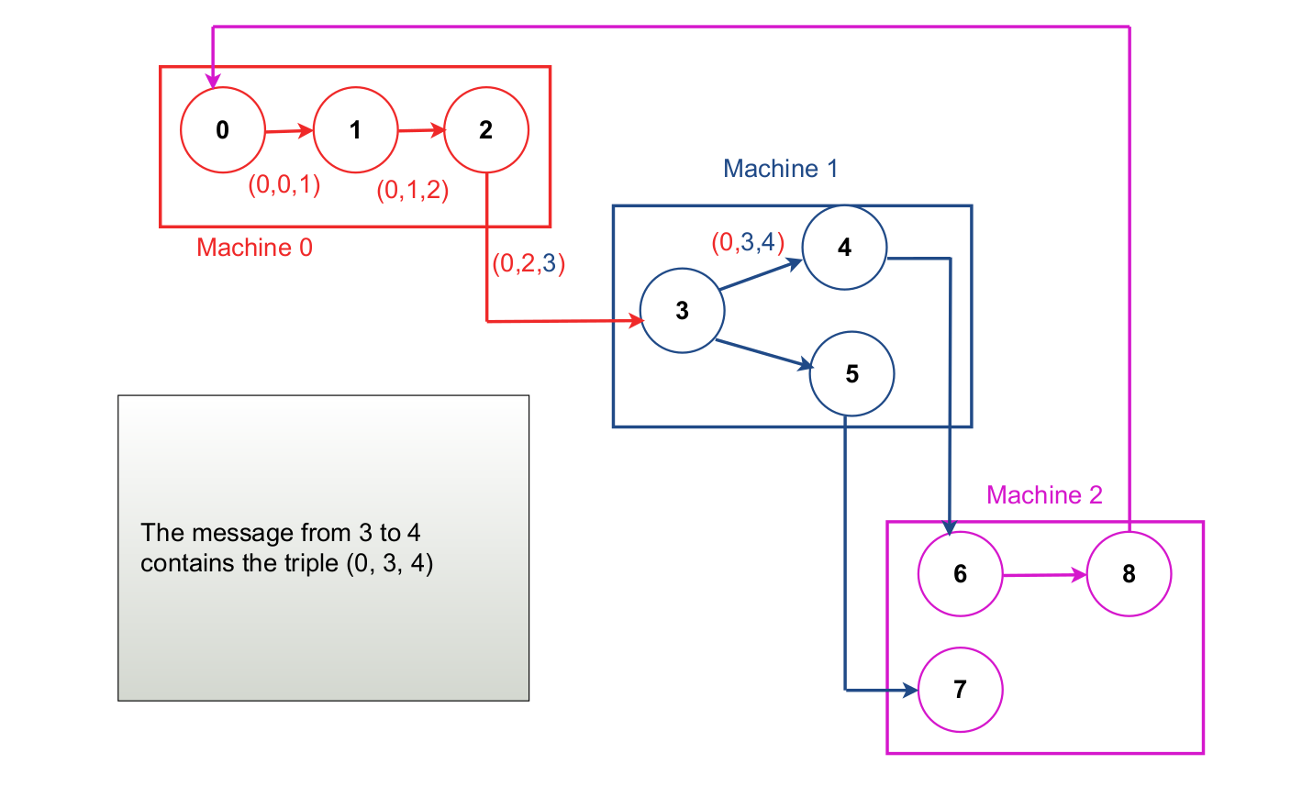
Cont..

Slide 22
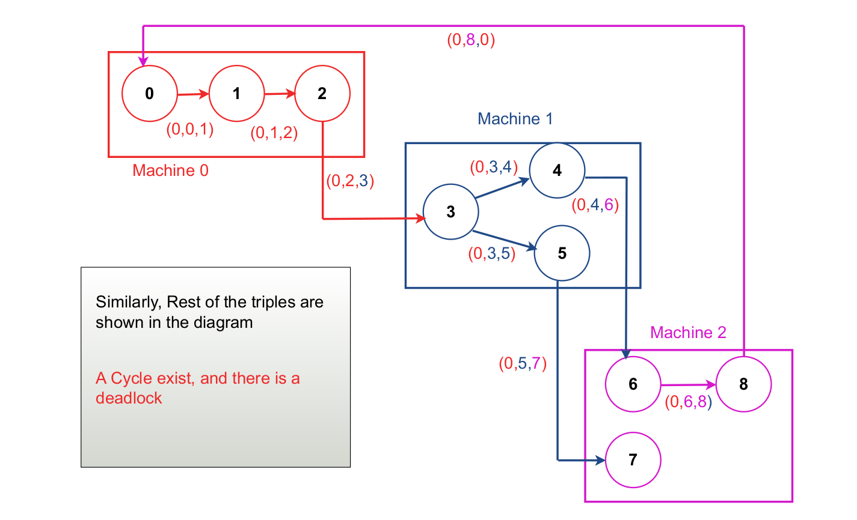
Cont..

Slide 23
Cont..
There are various ways to in which the deadlock can be broken:
One way is to have the process that initiated the probe commit suicide.
However, this method has problems if several processes invoke the algorithm simultaneously.
For example, imagine that both 0 and 6 block at the same moment, and both initiated probes.
Each would eventually discover the deadlock, and each would kill itself. It is overkill.
Getting rid of one of them is enough.
2. An alternative approach is to have each process adds its identity to the end of the probe message so that when it returned to the initial sender, the complete cycle would be listed.
The sender can then see which process has the highest number, and kill that one or send it a message to kill itself.

Slide 24
Distributed Deadlock Prevention
Possible Solutions:
One way is to order the resources and require processes to acquire them in strictly increasing order. This approach means that a process can never hold high resources and ask for a low one, thus making cycles impossible.
With global timing and atomic transactions in a distributed system, two other methods are possible – both based on the idea of assigning each transaction a global timestamp at the moment it starts.
1. When one process is about to block, waiting for a resource that another process is using, a check is made to see which has a larger timestamp (i.e., is younger).
We can then allow the wait only if the waiting process has a lower timestamp (i.e., is older).
Here, the timestamp is always increasing if we follow any chain of waiting processes, so cycles are impossible.

Slide 25
Cont..
2. Alternatively, we can allow processes to wait only if the waiting process has a higher timestamp than the process waited for; here, the timestamps decrease along the chain.
Although both methods prevent deadlock, it is wiser to give priority to older processes because:
They have run longer, so the system has a larger investment in these processes.
They are likely to hold more resources
A young process that is killed off will eventually age until it is the oldest one in the system, and that eliminates starvation.
Killing a transaction is relatively harmless since, by definition, it can be restarted safely later.
To make this technique clear, two algorithms are discussed next.

Slide 26
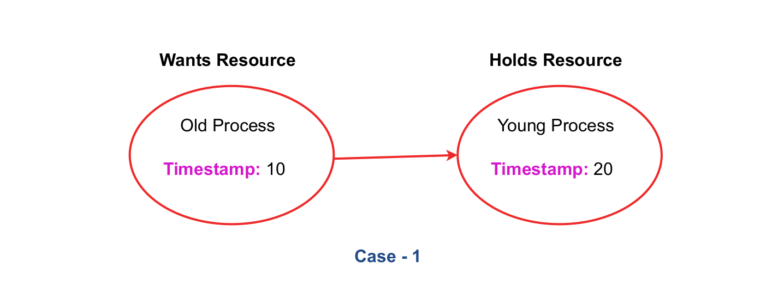
Cont..
Types of Algorithm:
1. Wait-Die deadlock prevention algorithm:
CASE - 1: Here, Old Process wants a resource held by young process.

Slide 27
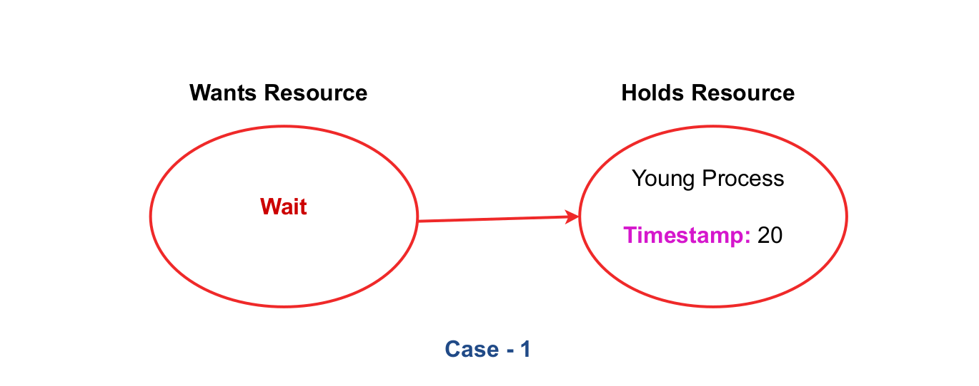
Cont..
So the old one will wait.

Slide 28
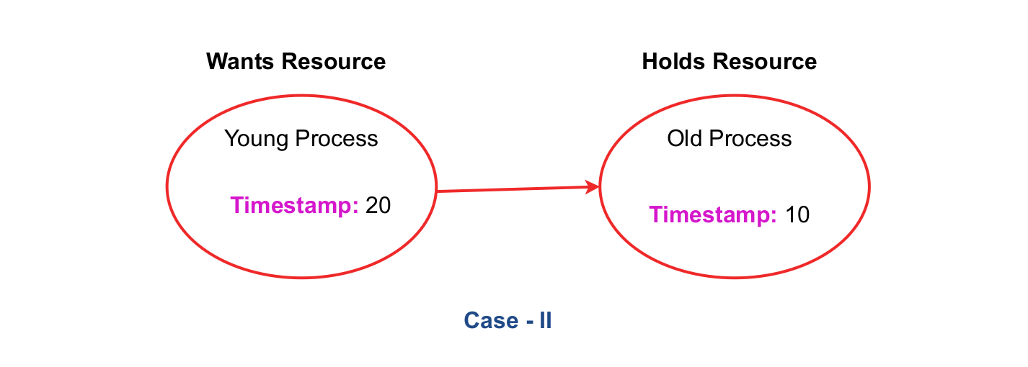
Cont..
CASE - 2: Here, Young Process wants a resource held by Old process.

Slide 29
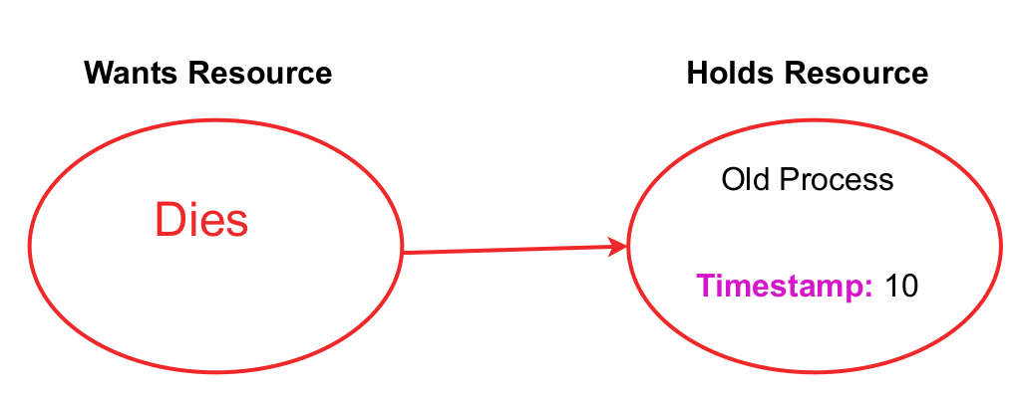
Cont..
So the Young process will be killed.

Slide 30
Cont..
Observation:
The young process, after being killed, will then start up again and be killed again. This cycle may go on many times before the old one releases the resource.
Once we are assuming the existence of transactions, we can do something that has previously been forbidden: take resources away from running processes.
When a conflict arises, instead of killing the process of making the request, we can kill the resource owner.
Without transactions, killing a process might have severe consequences.
With transactions, this effect will vanish magically when the transaction dies.

Slide 31
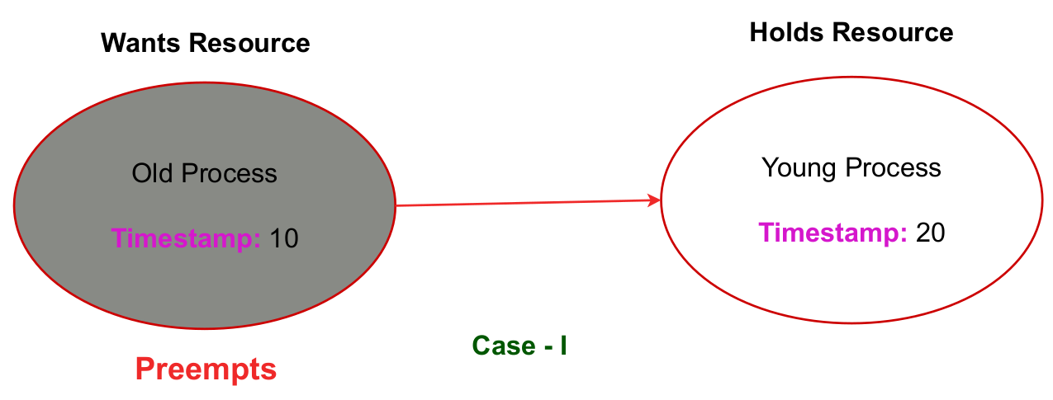
Cont..
2. Wound-Wait deadlock Prevention Algorithm:
If an Old process wants a resource held by a Young process, the old one will preempt the young process – whose transaction is then killed.

Slide 32
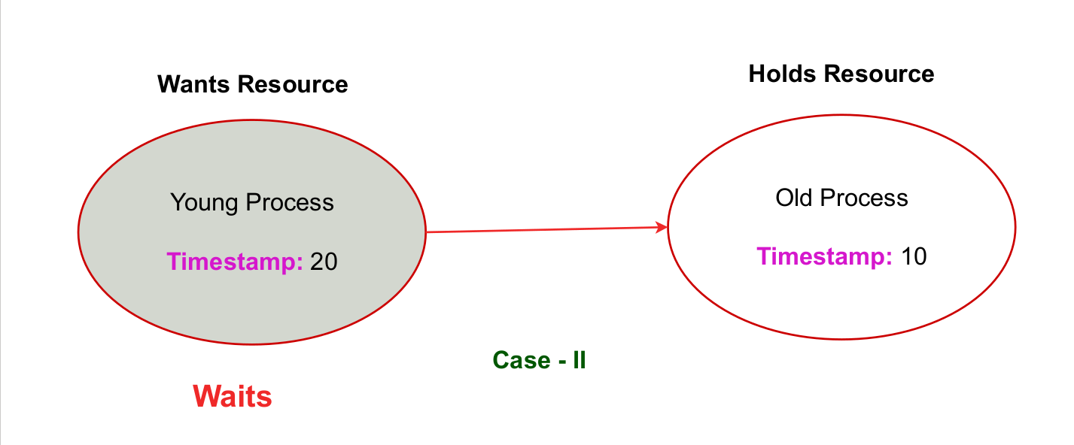
Cont..
If a Young process wants a resource held by an Old process, the Young one will wait.

